Slide 1


Bhoj Reddy Engineering College for Women
(Sponsored by Sangam Laxmibai Vidyapeet, Accredited by NAAC with A grade approved by AICTE and affiliated to JNTUH) Vinaynagar, IS Sadan Crossroads, Saidabad, Hyderabad – 500 059, Telangana. www.brecw.ac.in
Department of Computer Science and Engineering(AI&ML)
Mini Project Design Seminar on
AI-Based Intelligent Online Exam Proctoring System
Internal Guide: E.Drakshavalli Date : 21 February 2026
Assistant Professor Batch No:26MP02
CSE(AI&ML)- Coordinator:Sameera Begum VJS Pranathi 23321A6620
Assistant Professor B Akshitha 23321A6602
A Harshitha 23321A6613
Dr M Seshu Bhavani Dr G Shyama Chandra Prasad
Associate Professor & Head Professor & Principal

Slide 2
Introduction
Online examinations have become increasingly popular due to the growth of digital education. However, maintaining fairness and preventing malpractice during online exams is a major challenge. Traditional online exam systems rely on manual monitoring by human proctors, which is inefficient and error-prone.
To address these issues, this project proposes an AI-Based Intelligent Online Exam Proctoring System that automatically monitors students using computer vision techniques and identifies suspicious behavior during examinations.

Slide 3
Scope
The scope of the proposed system includes real-time monitoring of students through webcams to ensure exam integrity. The system automatically detects suspicious activities such as absence of face, presence of multiple faces, and frequent looking away from the screen.
It generates a cheating score and stores exam results in a database for proctor review. The system reduces manual supervision and can be extended in the future to include eye tracking, object detection, and advanced analytics.

Slide 4
Existing System
In the existing online examination system, proctors manually monitor students through live video feeds. The effectiveness of monitoring depends entirely on human attention.
Such systems lack automated cheating detection, are difficult to scale for large numbers of students, and do not provide structured reports for later analysis.
Disadvantages of Existing System
High dependency on human proctors
Time-consuming and labor-intensive
Limited scalability
Prone to human error
No automatic detection of cheating behavior
No structured evidence or exam logs

Slide 5
Proposed System
The proposed system uses artificial intelligence and computer vision techniques to automatically monitor students during online examinations.
A pre-trained face detection model detects student presence. Rule-based behavior analysis is applied to identify suspicious activities such as no face detected, multiple faces detected, and looking away from the camera.
The system calculates a cheating score and classifies the exam session as Normal, Suspicious, or Cheating, and stores results in a database for proctor review.
Advantages of Proposed System:
Automated cheating detection
Reduced human effort
Real-time monitoring
Scalable for large exams
Consistent and unbiased evaluation
Secure storage of exam results

Slide 6
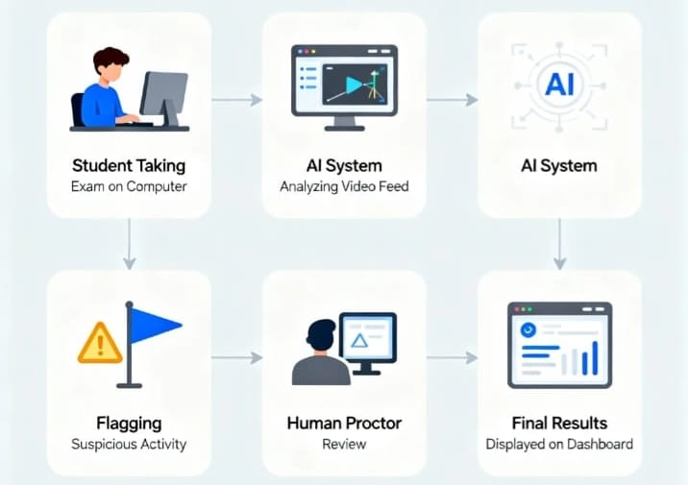
Project Flow

Slide 7
Requirement Analysis
Functional Requirements:
Student Module:Enables students to securely attend online exams with real-time AI monitoring and result submission.
Proctor Module:Allows proctors to monitor exams live, review suspicious activities, and access cheating reports.
Admin Module:Manages users, schedules exams, configures system settings, and oversees overall reports.
Non-Functional Requirements:
Performance – The system should monitor students in real-time with minimal delay (within 2 seconds).
Scalability – The system should handle a large number of students simultaneously.
Reliability – The system should operate continuously without crashes during exams.
Security & Privacy – The system should protect student data and follow privacy policies.
Usability – The system should provide an easy and user-friendly interface.
Maintainability – The system should be easy to update and extend with new features.
Platform Independence – The system should work across different operating systems.

Slide 8
Computational Resources
SOFTWARE REQUREMENTS
Operating System: Windows 10
Programming Language: Python
Frontend Technologies: HTML,CSS
Backend Technologies: Flask
Database: SQLite
Libraries: OpenCV, Dlib, SQLite
IDE: VS Code / PyCharm
HARDWARE REQUIREMENTS:
Processor: Intel i5 or above
RAM: 8 GB
Webcam
Storage: 100 GB

Slide 9
Design
In software engineering, "design" refers to the process of planning and defining how a software system will work.
It involves creating a blueprint for the software, including its structure, components, and how they will interact.
The goal of design is to solve problems and specify how the software will meet user requirements.

Slide 10
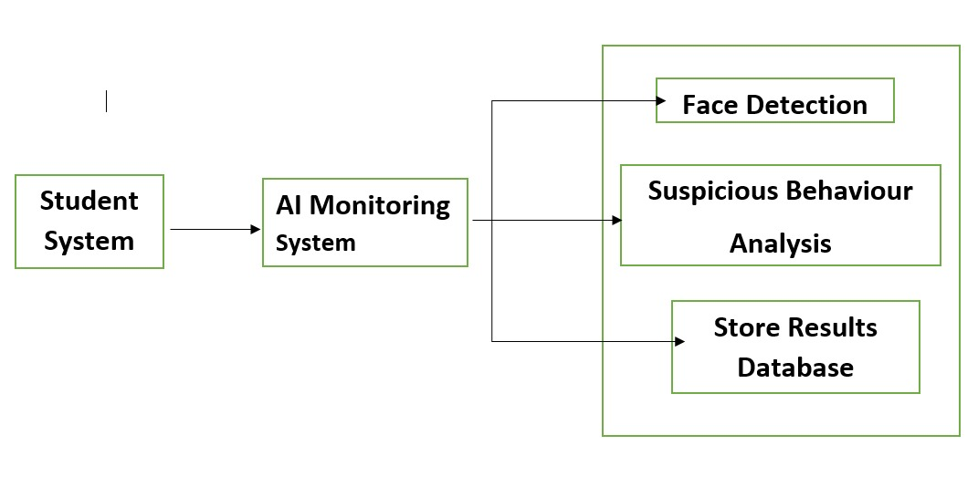
System Architecture

Slide 11
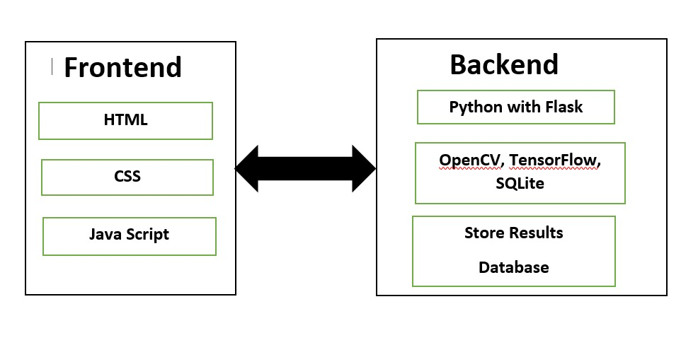
Technical Architecture

Slide 12
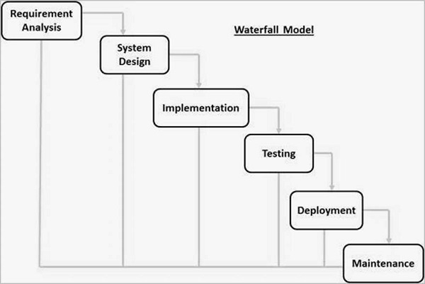
Software Process Model
Waterfall Model

Slide 13
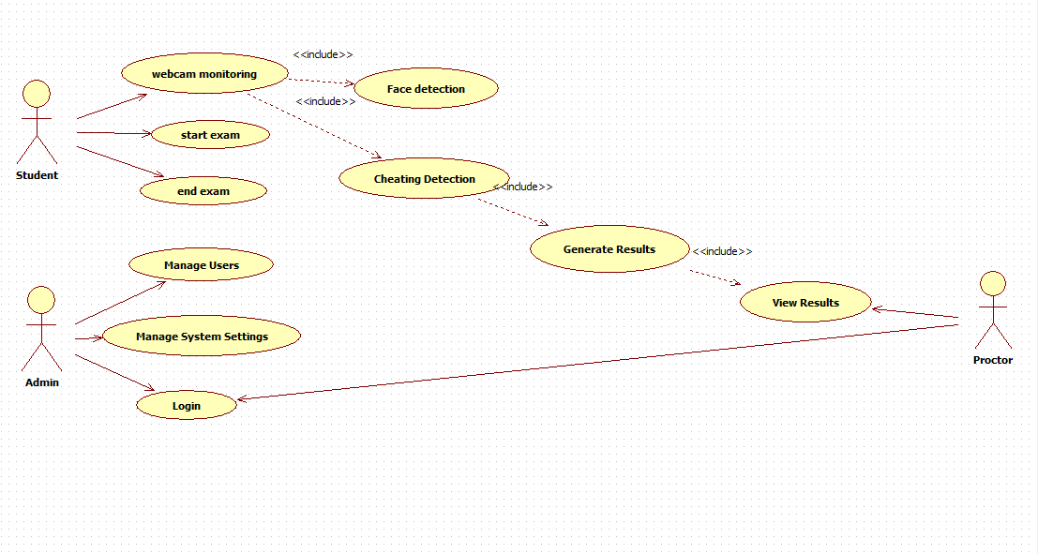
1.USECASE DIAGRAM

Slide 14
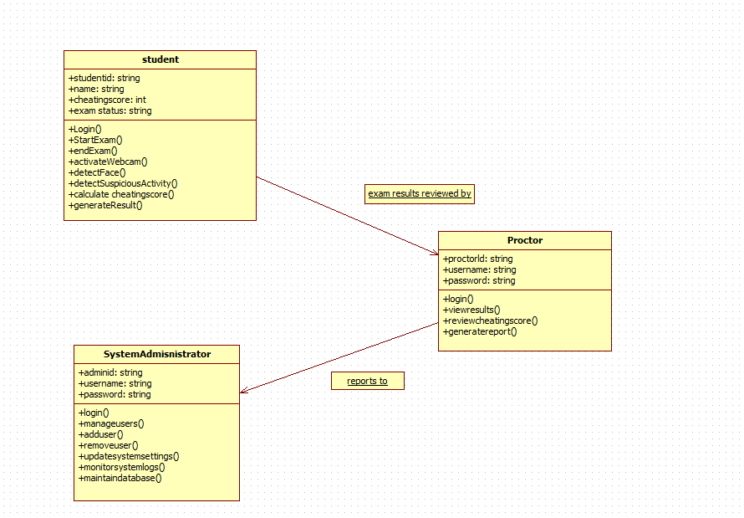
2. CLASS DIAGRAM

Slide 15
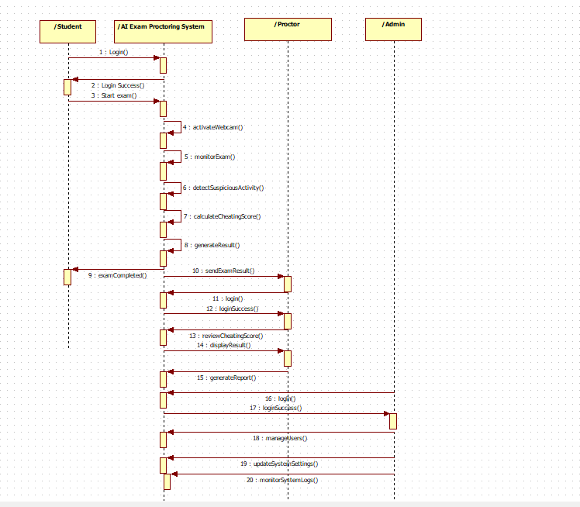
3.SEQUENCE DIAGRAM

Slide 16
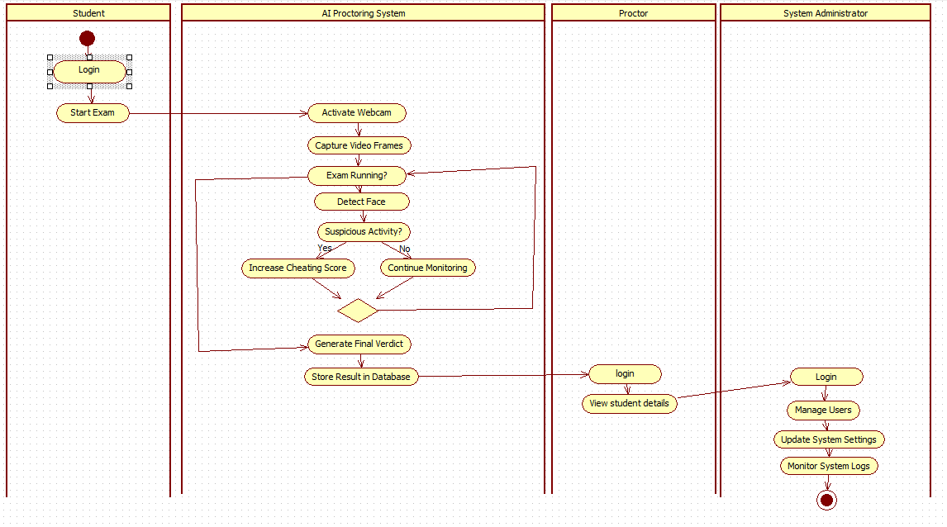
4. ACTIVITY DIAGRAM

Slide 17
Data Flow Diagram
The data flow begins when the student logs in and starts the exam, sending live webcam video to the AI monitoring system. The system processes the video frames using face detection and suspicious behavior analysis modules to monitor exam activity and calculate a cheating score.
Student details are verified using the registration database during login. Once the exam is completed, the system generates a final verdict based on the cheating score and stores the results in the exam records database.
The examiner can then access the stored reports and review the student’s performance through the dashboard.

Slide 18
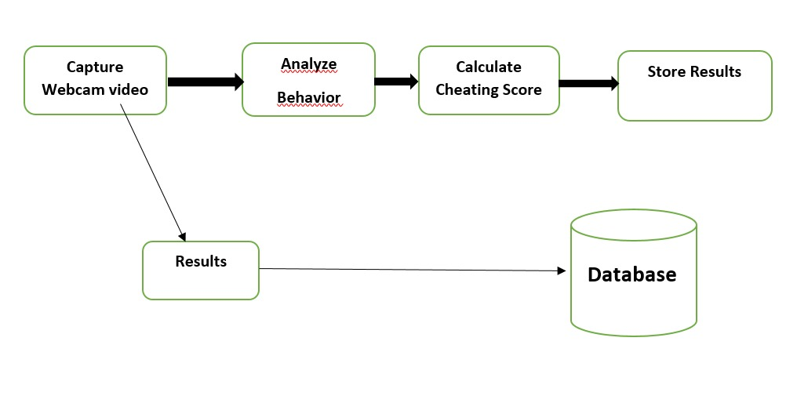
Data Flow Diagram

Slide 19
Implementation Steps and Algorithm
IMPLEMENTATION STEPS
Requirement Analysis Identified the need for automated online exam monitoring and defined system scope.
Technology Selection Used Python, OpenCV, Flask, SQLite, HTML, and CSS.
Face Detection Integration Integrated a pre-trained face detection model and captured live webcam video.
Cheating Detection Logic Increased cheating score if no face or multiple faces were detected. Generated final verdict based on threshold.
Database Implementation Stored Student ID, cheating score, verdict, and timestamp in SQLite.
Web Dashboard Development Created proctor login and results dashboard connected to Flask backend.
Testing and Validation Tested different scenarios and verified score calculation and data storage.

Slide 20
ALGORITHM
Step 1: Initialize Start webcam, load face detection model, set cheating score to 0.
Step 2: Capture Frame Read video frame from webcam.
Step 3: Detect Faces Apply model and count detected faces.
Step 4: Evaluate No face or multiple faces → increase cheating score. Single face → continue monitoring.
Step 5: Display Show monitoring status and cheating score in real time.
Step 6: End Exam On pressing ‘Q’, stop webcam and calculate final verdict.
Step 7: Store Result Save student ID, score, verdict, and timestamp in database.

Slide 21
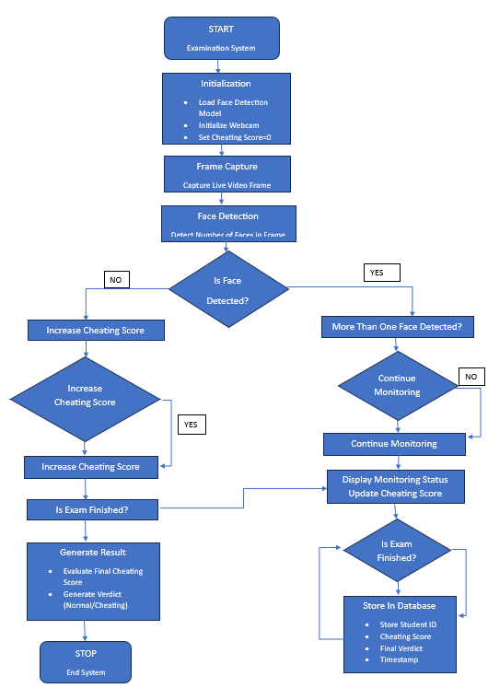

Slide 22
Implementation
Input:
The system captures live webcam video frames of the student during the examination.
Each frame is represented as an image matrix:
(height × width × channels)
Example:
224 × 224 × 3
Where the three channels represent RGB color values.
These frames are processed to detect faces and analyze student behavior.

Slide 23
Face Detection Process
Capture frame from webcam
Apply face detection model
Detect number of faces in the frame
Decision rules:
0 faces → cheating detection
1 face → normal monitoring
More than 1 face → cheating detection

Slide 24
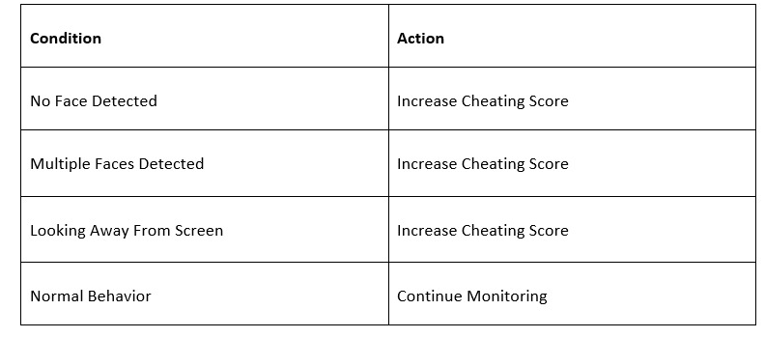
Behavior Detection
The system checks whether the student is looking away from the screen.
If the detected face center is far from the frame center, the system considers it suspicious behavior.
Examples:

Slide 25
Implementation(Pseudo Code)
Initialize webcam
Load face detection model
cheating_score = 0
while exam_running:
capture frame from webcam
detect faces in frame
if no face detected:
cheating_score += 1
elif multiple faces detected:
cheating_score += 5
else:
check face position
if looking away:
cheating_score += 2
display cheating score
if exam ends:
calculate final verdict
store result in SQLite database

Slide 26
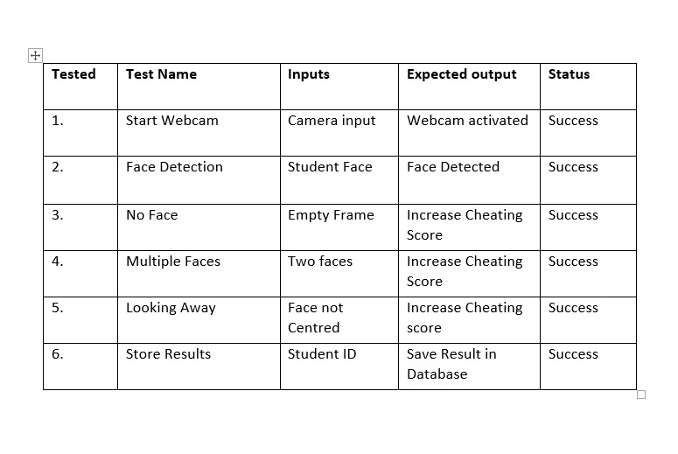
Test Cases:

Slide 27
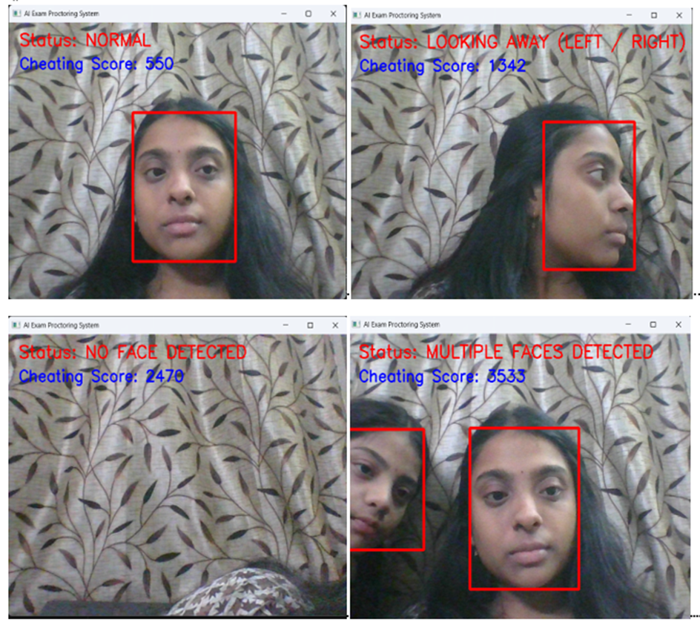
Final Output

Slide 28

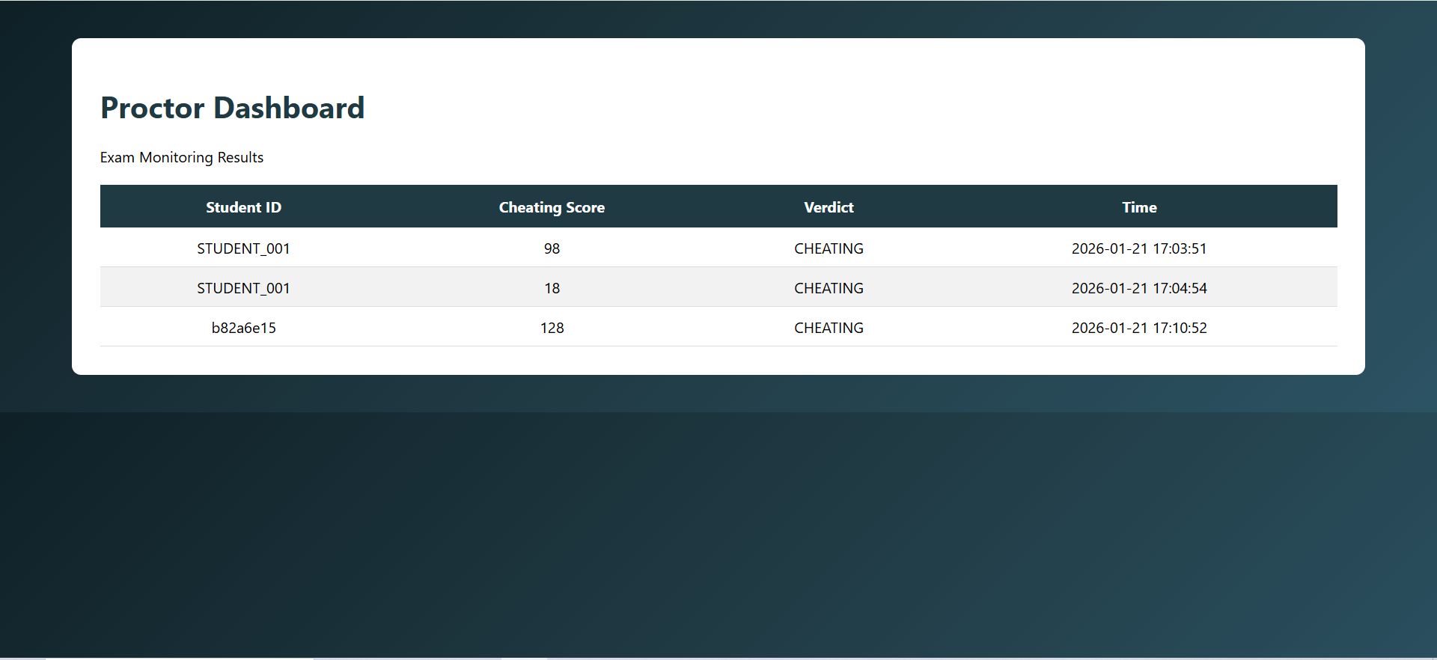

Slide 29

Pre-trained Model
The system uses a pre-trained face detection model provided by computer vision libraries such as OpenCV. This model is trained on large datasets and can accurately detect human faces in images and video streams.
During the examination, the system captures webcam frames and applies the face detection model to identify the presence of faces. Based on the detected faces and their positions, the system analyzes student behavior and calculates a cheating score.
Using a pre-trained model eliminates the need for training a new dataset and allows the system to perform real-time monitoring efficiently.

Slide 30
Conclusion
The AI-Based Intelligent Online Exam Proctoring System provides an automated solution for monitoring students during online examinations.Using computer vision techniques, the system detects faces and identifies suspicious activities such as absence of face, multiple faces, or looking away from the screen.
The system calculates a cheating score and stores the results in a database, allowing proctors to review exam sessions through a dashboard.This approach reduces human effort and improves the reliability and fairness of online examinations.

Slide 31
Future Scope
The system can be enhanced in the future by integrating more advanced technologies such as:
Eye movement tracking for better attention monitoring
Head pose estimation for improved behavior analysis
Audio monitoring to detect suspicious conversations
Object detection to identify unauthorized materials like phones or books
Cloud deployment for large-scale online examination systems

Slide 32
References
[1] P. Viola, M. Jones, “Rapid Object Detection using a Boosted Cascade of Simple Features,” IEEE Conference on Computer Vision and Pattern Recognition, 2001.
[2] G. Bradski, A. Kaehler, Learning OpenCV: Computer Vision with the OpenCV Library, O’Reilly Media, 2008.
[3] OpenCV Documentation, “Open Source Computer Vision Library,” Available: https://opencv.org

Slide 33

Thank You!

